Slide 1
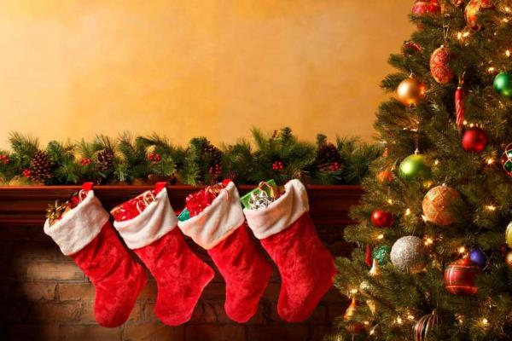
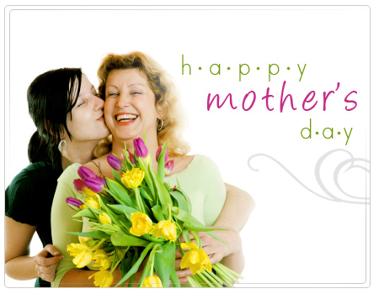
A Special occasion
Christmas
Holidays and Celebrations
Basic 3 Lesson A
Mother´s Day

Slide 2

What do people say on Christmas?
On Christmas, people say Merry Christmas

Slide 3
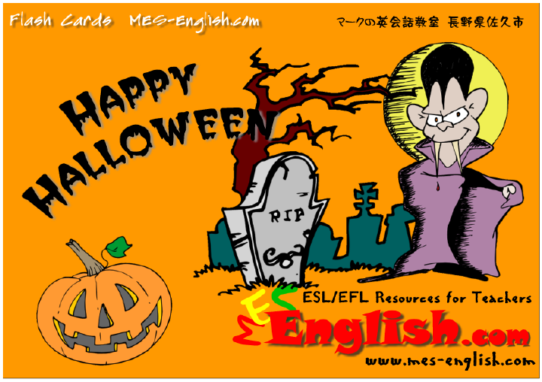
What do children say on Halloween?
On Halloween, children say Trick or treat

Slide 4
What do people say on _____?
(Holiday)
On ____, people say _____.
(Holiday)
(Expression)

Slide 5
My favorite day of the year is _______.
It is on __________.
On this day, I eat _______ and drink ________.
On this day, I go to __________. My family and I ___________

